Slide 1
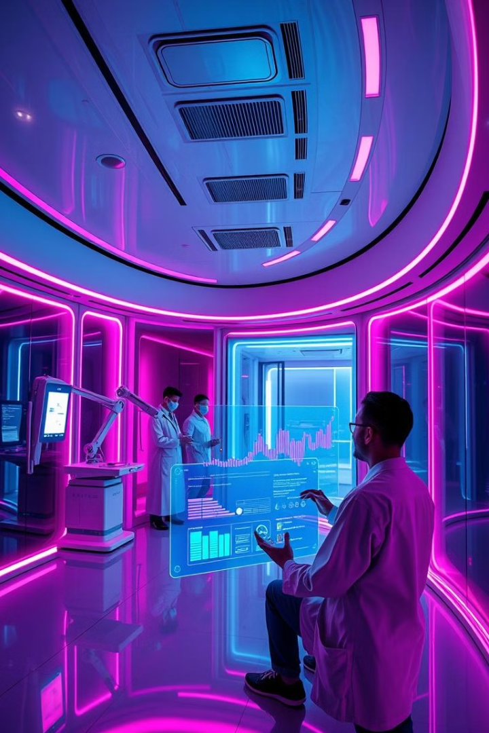
Medicine Recommendation System
innovative medicine recommendation system designed to revolutionize healthcare accessibility and improve patient outcomes.

Slide 2

Problem Statement
1
Lack of Guidance
2
Delayed Diagnosis
Patients often face difficulties in obtaining timely and accurate advice for their symptoms.
Diagnosis delays, especially in remote areas, can lead to complications and adverse health outcomes.
3
Information Overload
Navigating overwhelming medical information without personalized suggestions can be challenging.

Slide 3
Objective
Accurate Prediction
Personalized Recommendations
Accessible Platform
Our system leverages machine learning to predict diseases based on user-provided symptoms.
Tailored medicine suggestions and precautions are offered based on the predicted disease.
The platform provides a user-friendly and accessible interface for healthcare guidance.

Slide 4

Approach/Methodology
1
Data Collection
We gather extensive datasets encompassing symptoms, diseases, and associated medications.
2
Preprocessing
Data is meticulously cleaned and structured to ensure its suitability for machine learning.
3
Model Development
Advanced machine learning algorithms, such as SVC ,Decision Trees and Random Forests, are employed.
4
Recommendation Engine
Our system links predicted diseases to relevant treatments using a robust recommendation engine.

Slide 5
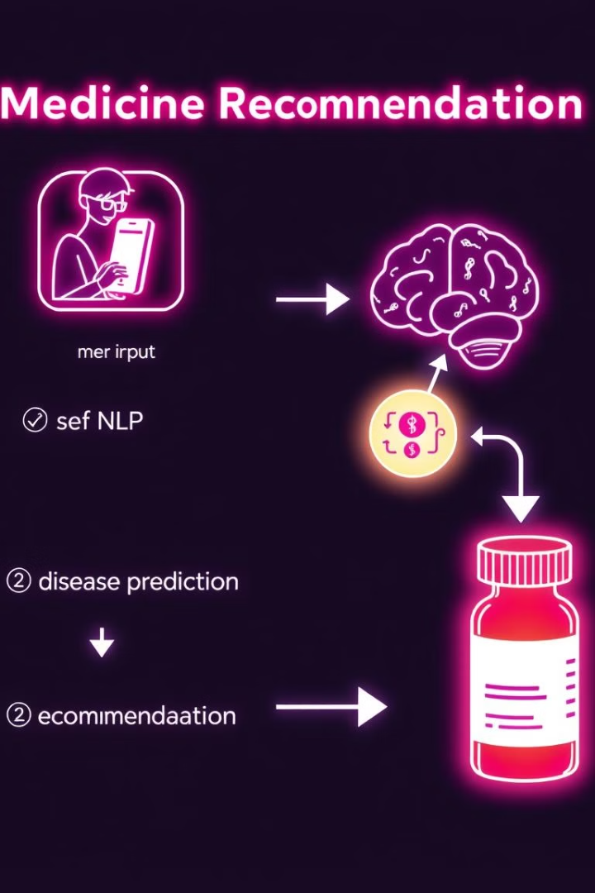




System Architecture
User Input
Users input their symptoms via the user interface.
Model Selection
SVC Model analyzes the input to understand the user's symptoms.
Disease Prediction
The trained machine learning model predicts the most likely disease based on the symptoms.
Recommendations
The system provides personalized medicine recommendations and precautionary advice.

Slide 6
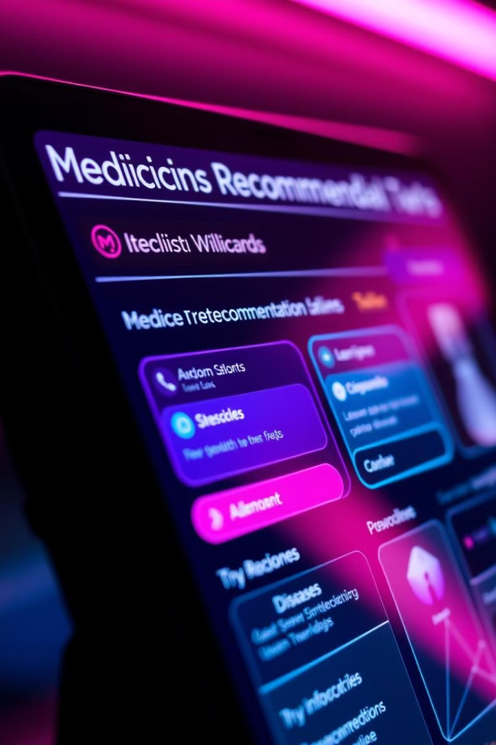
Key Features
Accurate Predictions
Personalized Recommendations
Our models are trained on vast datasets, ensuring high accuracy in disease prediction.
Medicine and precaution suggestions are tailored to the user's individual needs and predicted condition.
User-Friendly Interface
The intuitive platform provides easy access to the system's features and personalized guidance.

Slide 7
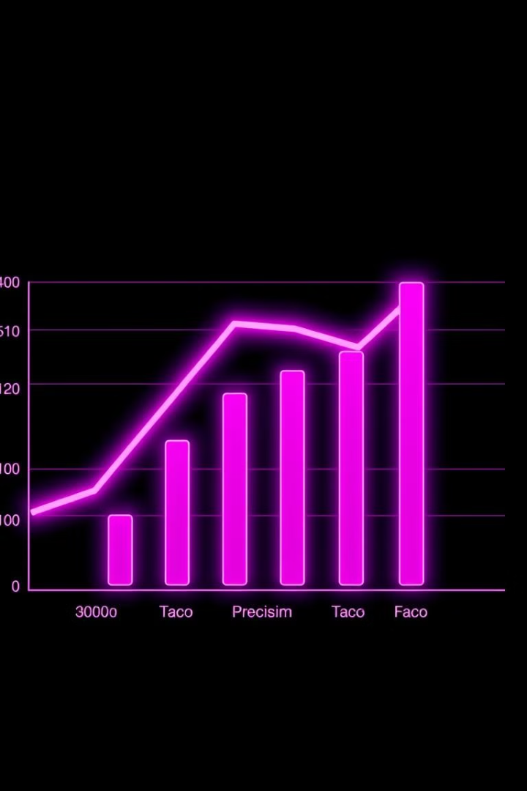
Experimental Results
Metric
Value
Accuracy
100%
Precision
100%
Recall
100%
F1-Score
100%

Slide 8




Future Scope
Real-Time Data
Multilingual Support
Advanced AI Models
Integrating real-time health data from wearables can enhance prediction accuracy.
Expanding the system to support multiple languages can improve global accessibility.
Exploring advanced AI models, like transformers, can further refine prediction and recommendation capabilities.

Slide 9
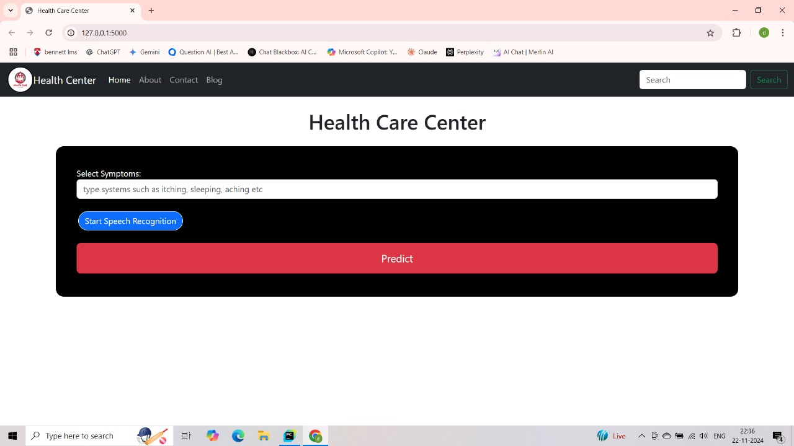
OUTPUT RESULTS

Slide 10
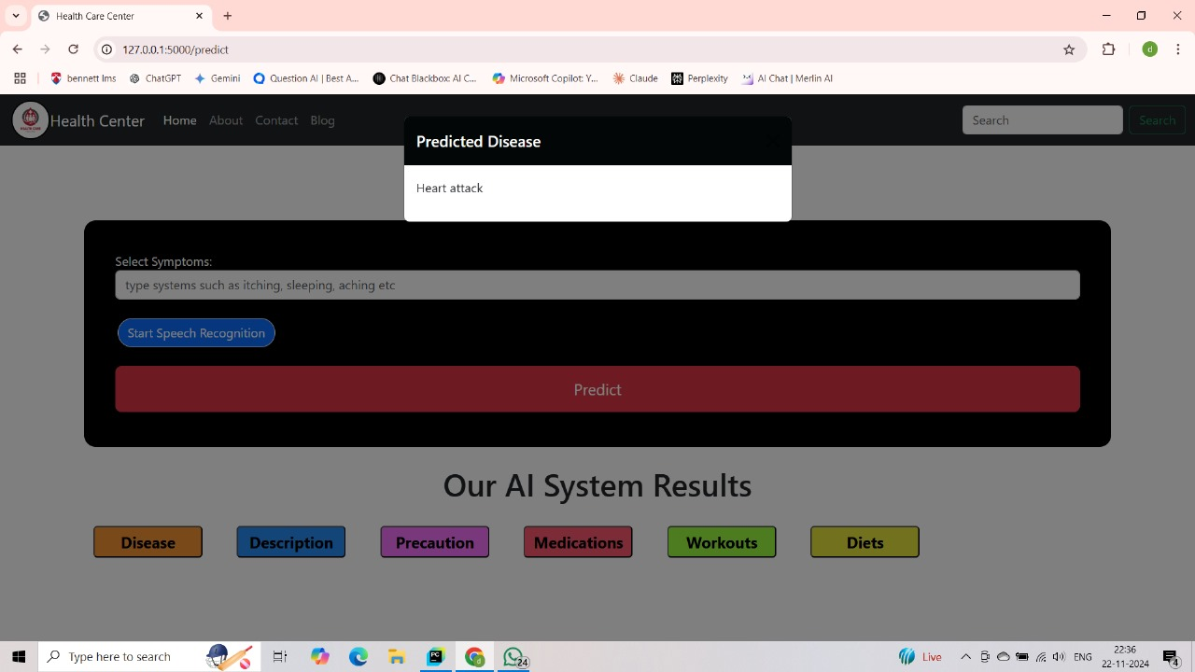

Slide 11
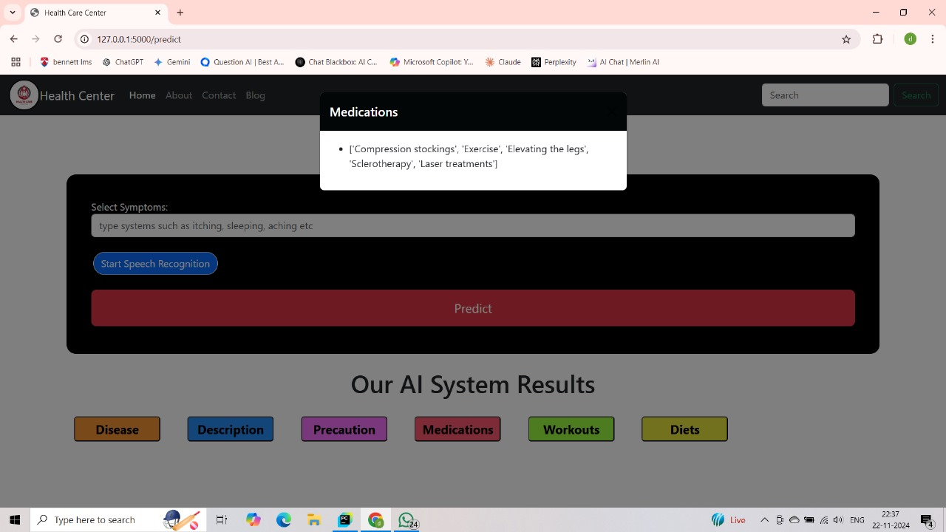

Slide 12
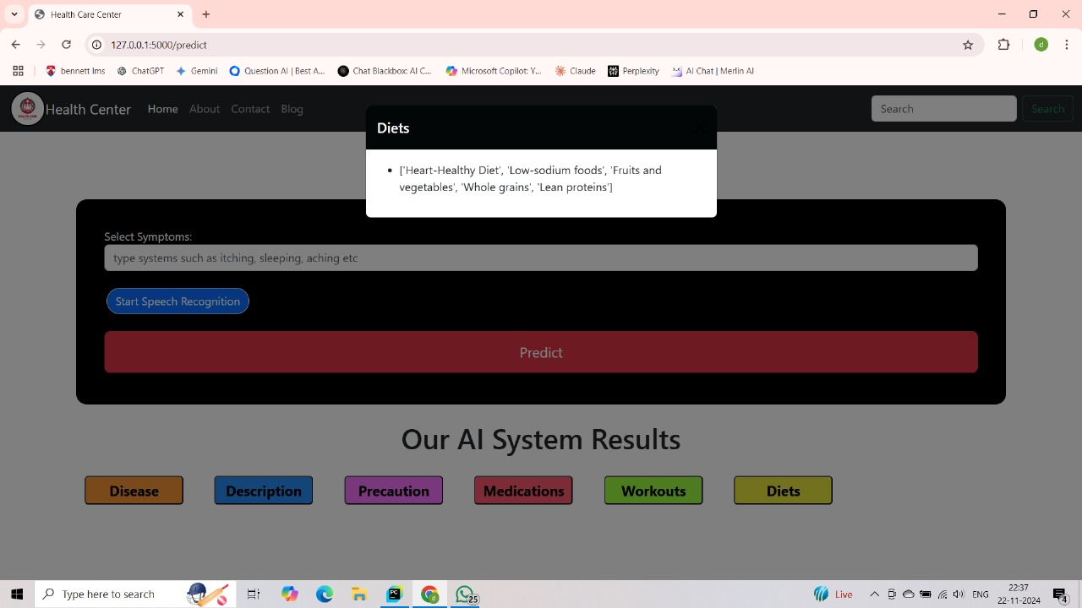

Slide 13
THANK YOU
Submitted by:
ANSHIKA SHARMA(E23CSEU0275)
DEVYANSH MITTAL(E23CSEU0297)
TEJSWEETA(E23CSEU0286)

